Slide 1
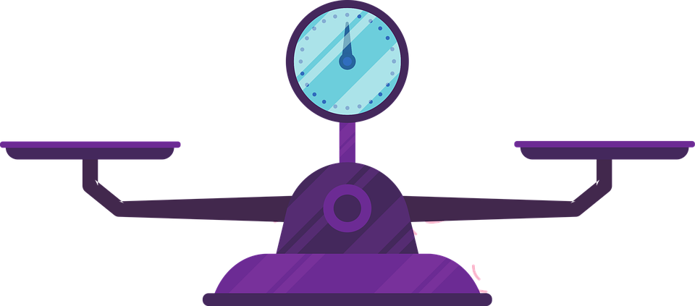
Left Side of Lever |  |  | Right Side of Lever
Name of Object on the Left Side | Distance from the Fulcrum (in centimeters) | Weight of Object on the Left Side | Name of Object on Right Side | Distance from the Fulcrum when Balanced (in centimeters) | Guess the Weight of the Object
standard weight | ____ cm | 10 grams |  | ____ cm | ____ grams
 |  |  |  | ____ cm | ____ grams
 |  |  |  | ____ cm | ____ grams
 |  |  |  | ____ cm | ____ grams
 |  |  |  | ____ cm | ____ grams

Slide 2
Directions: Pick one of your objects to and fill in the blanks to describe the math pattern. Type the name of the object into the green boxes. Type the distances in the purple boxes. Type the weight of the object you chose into the red box.
The 10 g weight was ___ cm from the fulcrum. When I placed the ______ ___ cm from the fulcrum the scale balanced. So, the weight of the ______ is ___ grams.

Slide 3
Directions: Pick one of the objects. Fill in the blanks to write an equation that shows the math relationship between the weight on the right side and that weight on the left side and the distance from the fulcrum.
10 g
standard weight in grams
distance from fulcrum in cm
weight of object in grams
distance from fulcrum in cm
Left Side
Right Side

